Slide 1
Planet Formation around Binary and Multiple Star Systems
Kyle Lindstrom
NAU, Lowell Observatory
Project Mentor: Lisa Prato

Slide 2

Motivation
The majority of stars in our Galaxy are not alone, but reside in binary or multiple systems
If we want to fully understand the planet formation process, we must study it in the context of these binary systems
http://www.nydailynews.com/life-style/scientists-star-wars-two-sun-planets-exist--1.2168170article

Slide 3
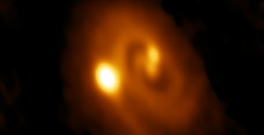
Planet Formation
Planets form in circumstellar disks around their host stars
To understand planet formation, we must determine the properties of the individual stars in these systems and their disks
It is more complicated, but important, to study these disks in binary and multiple systems
Tobin et al. (2016)

Slide 4
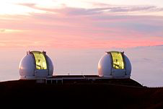
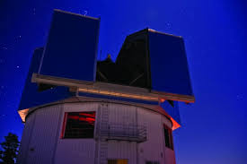
Project Overview
Our team observed over 100 young binaries in nearby star forming regions, with separations from 5 AU to 500 AU
I am now helping to create a model grid of synthetic spectra to compare with our observed binary spectra
Finally, we are developing a database which will include all the spectra we have analyzed and the stellar and disk properties of each system
https://en.wikipedia.org/wiki/W._M._Keck_Observatory
https://www2.nau.edu/researchnews-p/wordpress/index.php/nau-astronomers-get-more-observation-time-at-discovery-channel-telescope/
Keck Observatory and Lowell’s Discovery Channel Telescope

Slide 5
Stellar Spectra
The core of a star radiates light at many wavelengths, producing a continuum of emission
Elements in its atmosphere will absorb some of this light, with each element absorbing at a different wavelength
The dips in its spectrum are called absorption lines

Slide 6
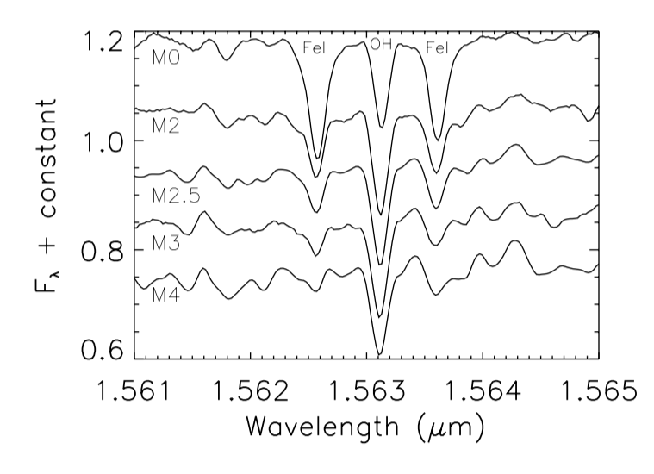
Stellar Properties: Temperature
Hotter stars show different absorption lines than cooler stars
As temperature increases, it excites elements into higher energy states, which increases the ability to absorb light
Molecules, however, are broken apart, and their ability to absorb light is inhibited
This leads to a change in the line ratio in an observed spectra
Prato (2007)

Slide 7
Example Spectra
In this system, the ratio of the characteristic Iron lines to the OH line changes from one star to the other
This tells us that the primary component has a higher temperature

Slide 8
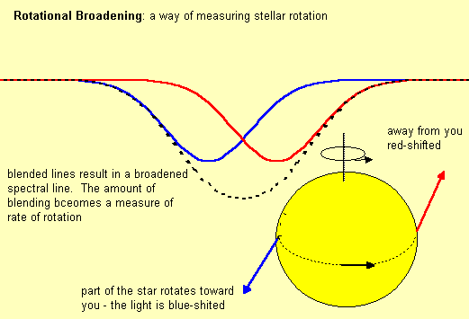
Stellar Properties: Rotation
As light moves away from you rapidly, its wavelength is stretched
As it moves towards you rapidly, its wavelength is compressed
This is referred to as Doppler Shift
In rapidly rotating stars, this effect causes absorption lines to be broadened
http://www.kcvs.ca/martin/astro/course/lectures/fall/a200l10g.htm

Slide 9
Example Spectra
In this system, the spectra are drastically different
The secondary component has shallow, broad absorption lines, which is an indicator that it is rapidly rotating

Slide 10
Stellar Properties: Veiling
In some star systems, gas from the disk falls onto the stellar surface
As this material accretes, it heats up, causing excess continuum emission
This emission can fill in absorption lines in the stars spectrum
https://www.youtube.com/watch?v=VMU3Sd-lJd0

Slide 11
Example Spectra
In this system, the spectral lines look similar, but their lengths differ greatly
The secondary component seems to have ‘filled in’ absorption lines, which tells us it is being veiled

Slide 12
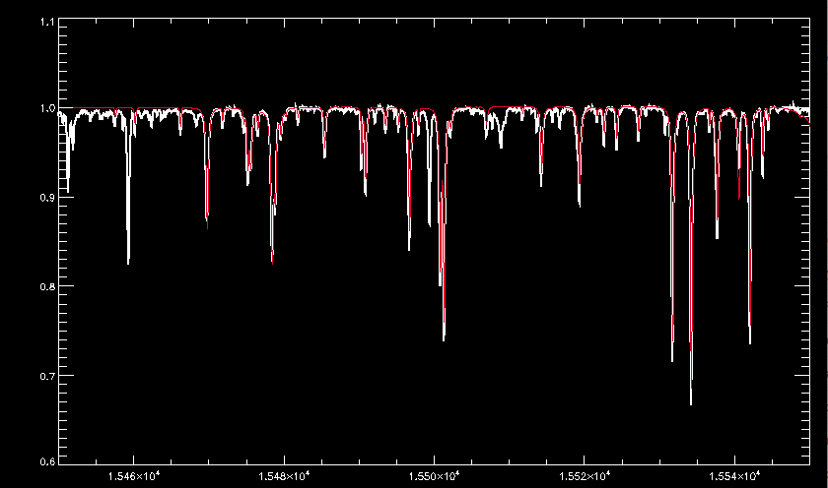
Model Grid
Our model incorporates parameters such as temperature, magnetic field, and surface gravity to create synthetic spectra
We vary these parameters to create thousands of spectra with a wide array of properties (temperature, veiling, rotation, magnetic field, surface gravity, radial velocity, etc)
We then compare our observed spectra to this grid to determine the properties of each observed star and disk

Slide 13
Database
All of the data will be easily accessible in one convenient location
We hope it will not only be helpful for our future research, but to anyone studying these binary and multiple systems

Slide 14


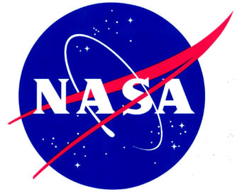
Acknowledgements
Northern Arizona University
Lowell Observatory
Arizona Space Grant Consortium
NASA
Dr. Lisa Prato
Dr. Nadine Barlow
Kathleen Stigmon

